Slide 1
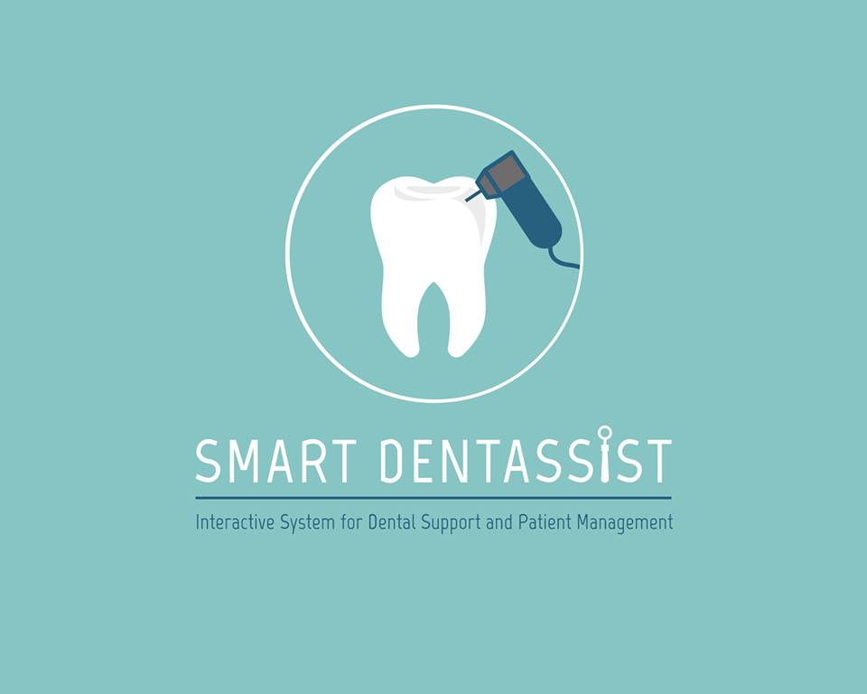

Slide 2


PATIENT MANAGEMENT SYSTEM
DENTAL INFORMATION KNOWLEDGE BASE
TELECONFERENCING SYSTEM
DIAGNOSIS, TREATMENT, SIMULATION

Slide 3
PATIENT MANAGEMENT SYSTEM
DENTAL INFORMATION KNOWLEDGE BASE
TELECONFERENCING SYSTEM
DIAGNOSIS, TREATMENT, SIMULATION

Slide 4
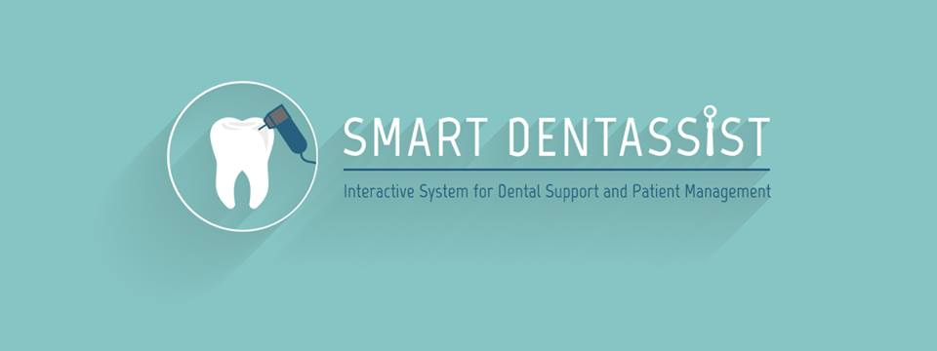
Patient Registration

Slide 5
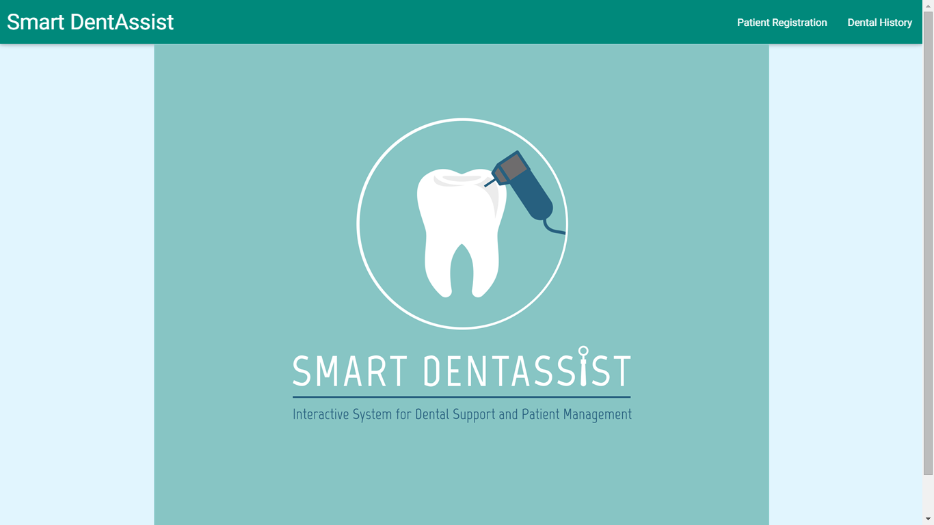

Slide 6
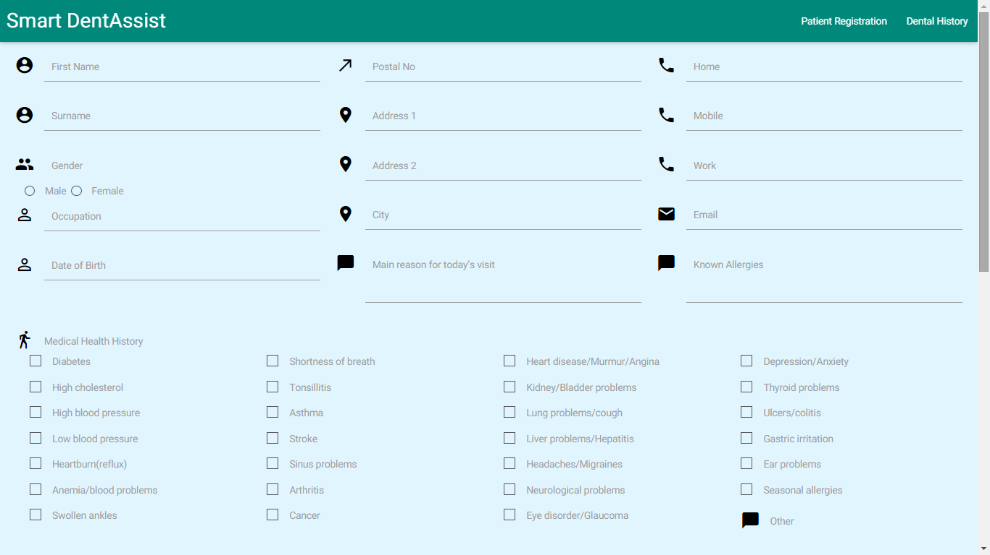

Slide 7
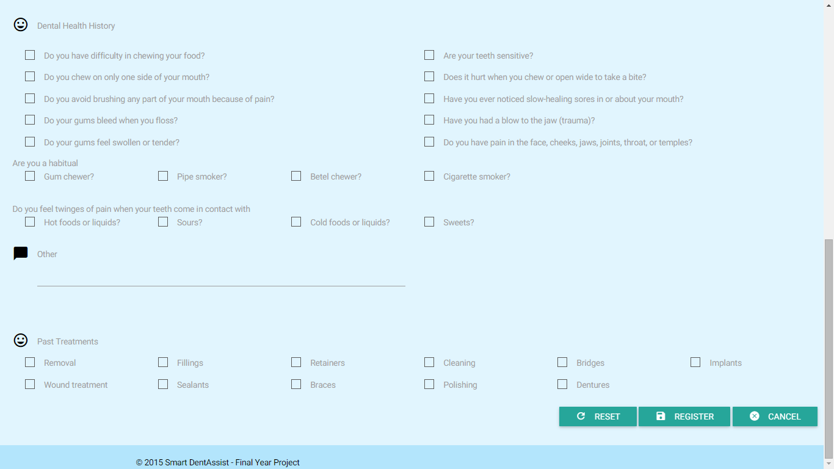

Slide 8
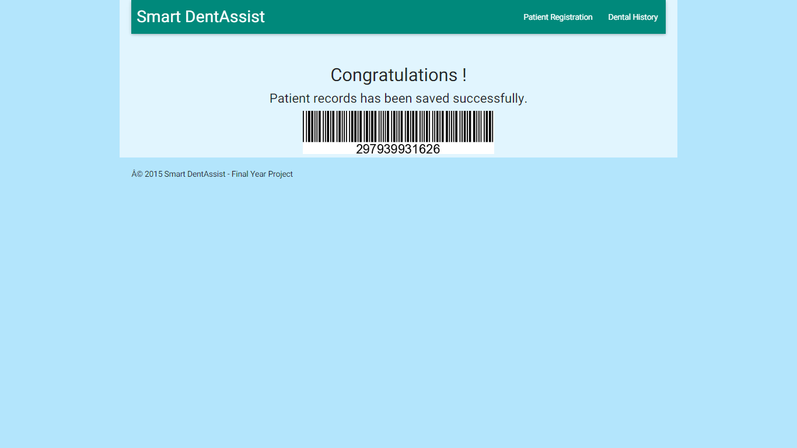

Slide 9
Dental Health History

Slide 11
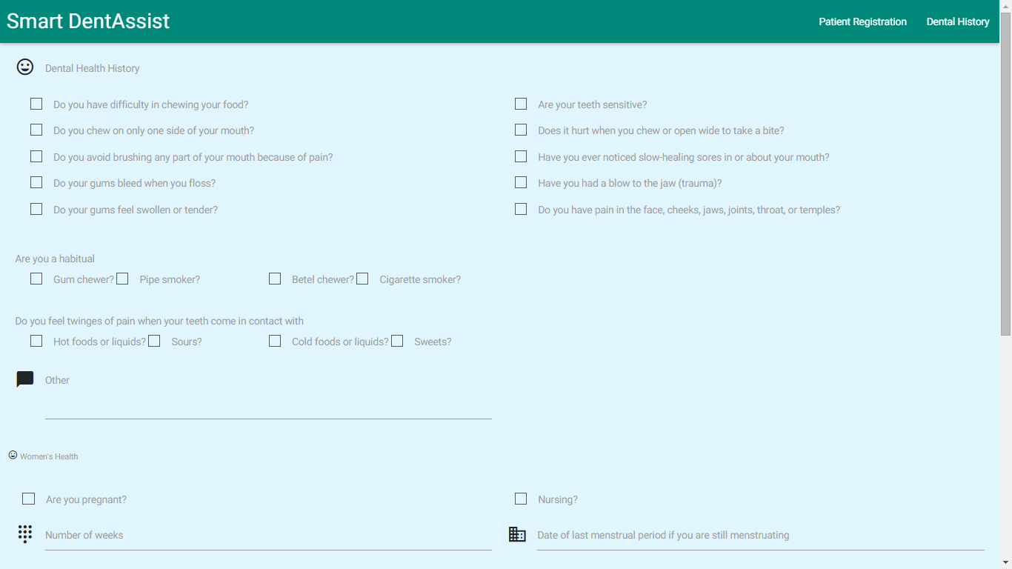
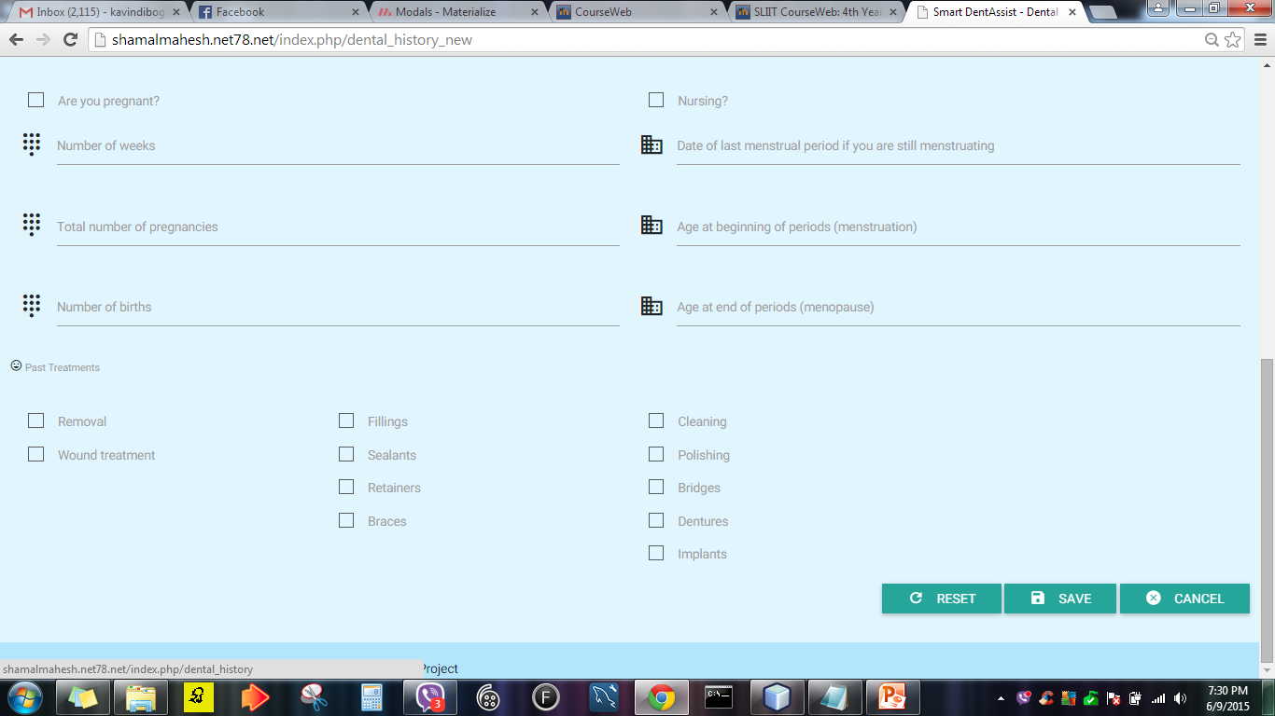

Slide 13
Patient Profile

Slide 14
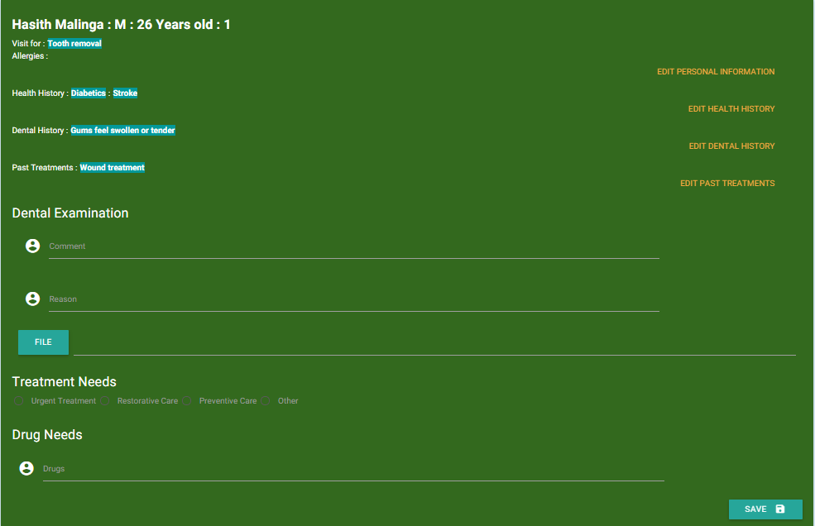

Slide 15
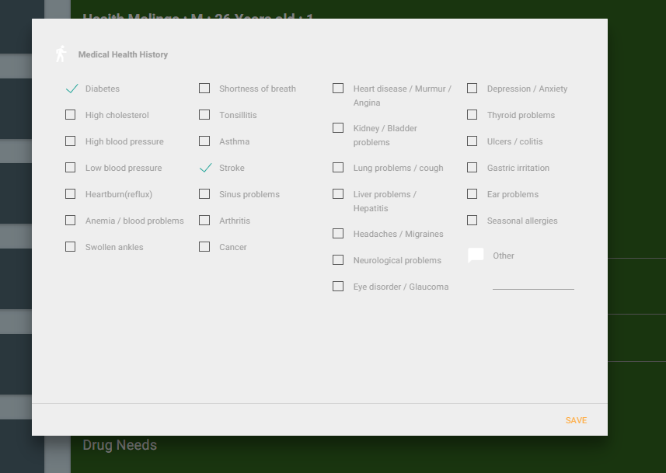

Slide 16
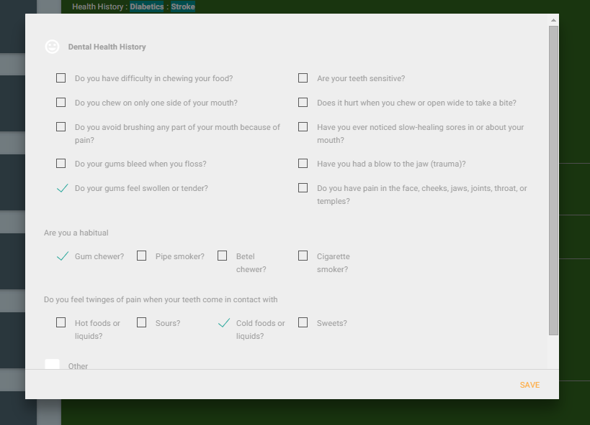

Slide 17
Patient Management System
The system registers new patients
The system generates unique barcode for each patient.
Images captured from intra oral cameras, medical history and all other relevant data are stored in patient folder.
Dentist can view the patient being treated as well as the list of patients who are waiting in queue
When the barcode is scanned, the patient's details will be displayed.

Slide 18
Patient Management System
Technologies Used
Php
JavaScript, jQuery
MySQL

Slide 19
PATIENT MANAGEMENT SYSTEM
DENTAL INFORMATION KNOWLEDGE BASE
TELECONFERENCING SYSTEM
DIAGNOSIS, TREATMENT, SIMULATION

Slide 20
Disease Images & Notes

Slide 21
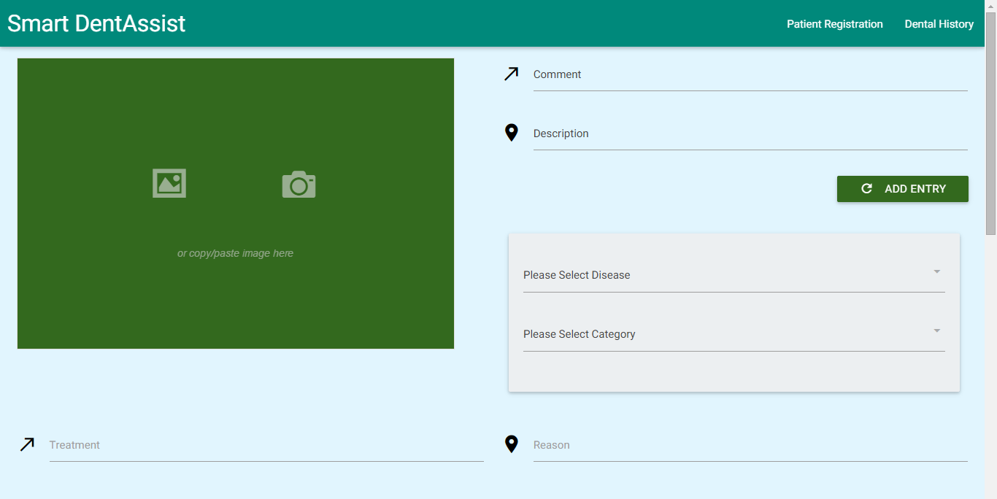

Slide 22
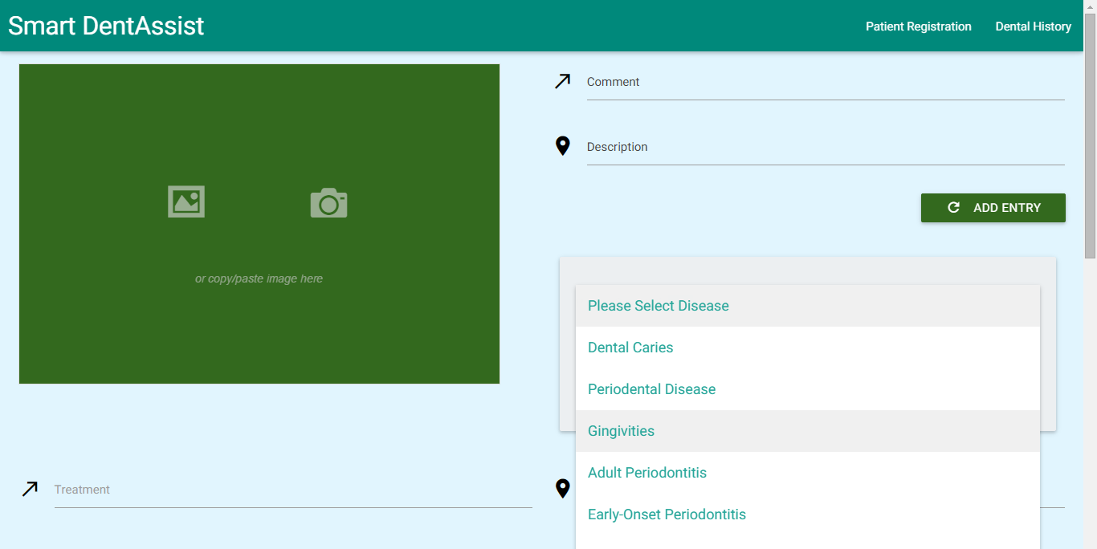
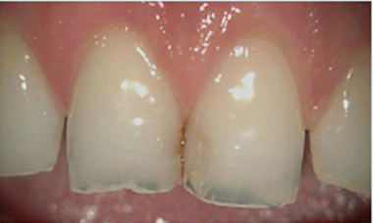

Slide 23
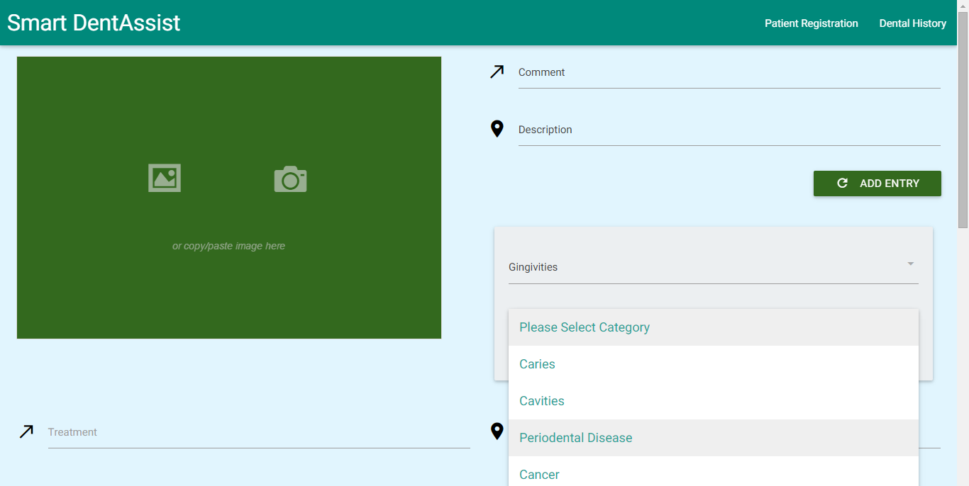

Slide 24
Diseases & Treatments

Slide 25
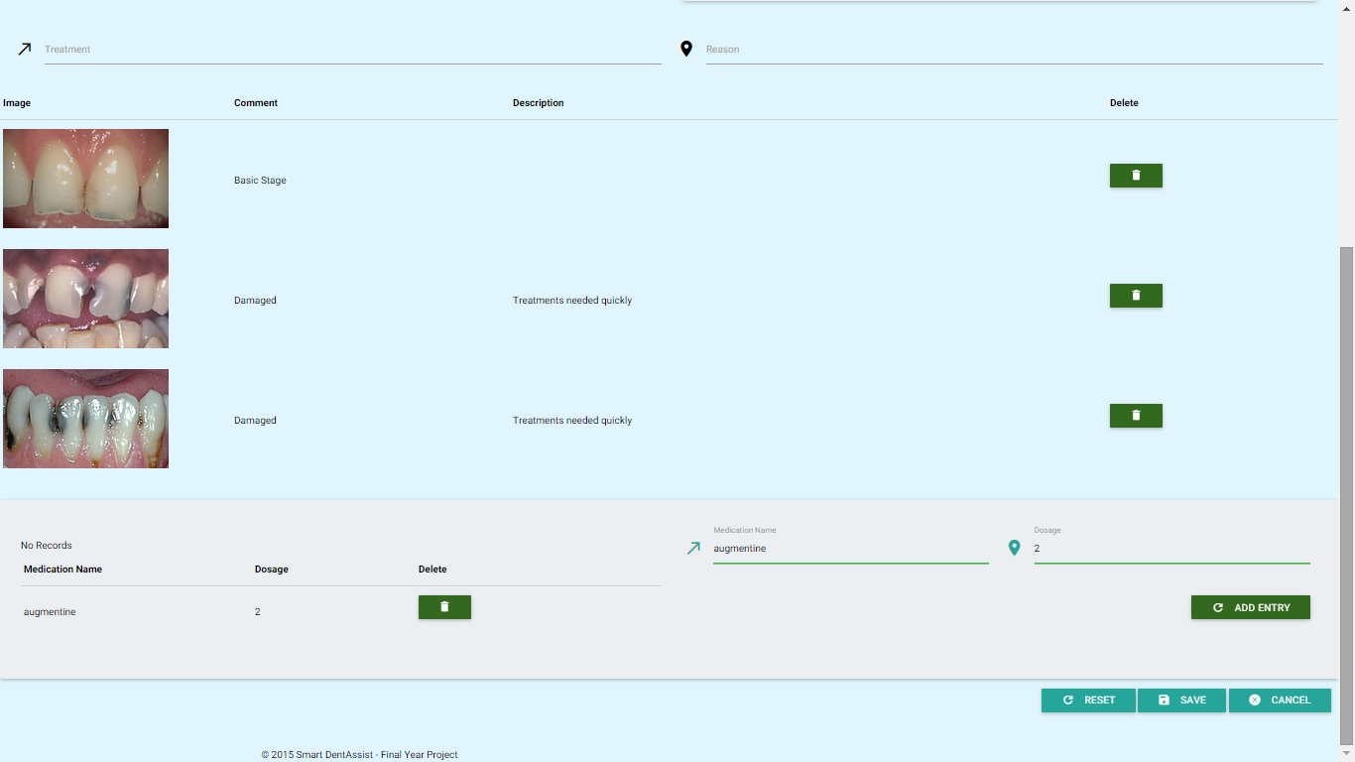

Slide 26
Previously Treated Cases

Slide 27
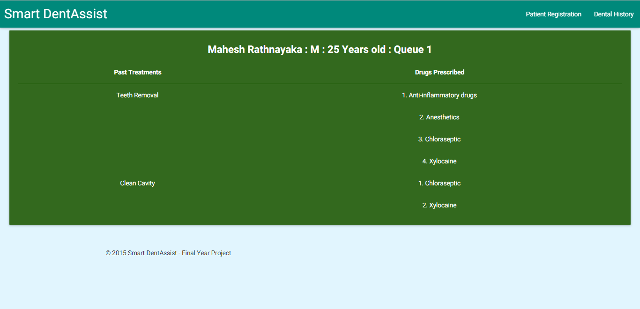

Slide 28
Dental Information Knowledge Base
The system stores images captured from intra oral camera along with their comments.
The dentist can edit intraoral images
The diseases will be categorized and images will be saved accordingly
Dentist can refer the knowledge base to check previously treated cases, treatments given, drugs used, and comments.
The system maintains independent timers for each patient to send reminders
This knowledge base provides the dentist with treatment suggestions
The system enables the dentist to create prescriptions
The system allows the sharing of the content in knowledge base with other dentists

Slide 29
Dental Information Knowledge Base
Technologies Used
Php
JavaScript, jQuery
MySQL

Slide 30
PATIENT MANAGEMENT SYSTEM
DENTAL INFORMATION KNOWLEDGE BASE
TELECONFERENCING SYSTEM
DIAGNOSIS, TREATMENT, SIMULATION

Slide 31
Live Stream - Intraoral Camera

Slide 32
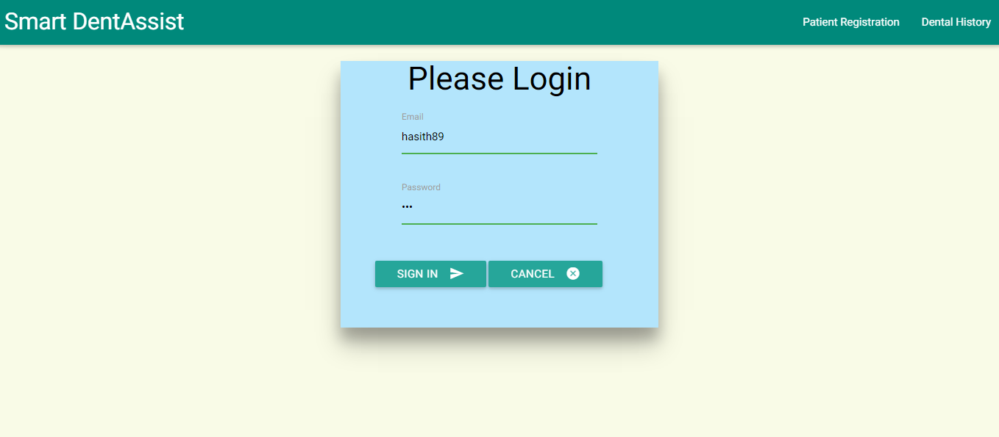

Slide 33
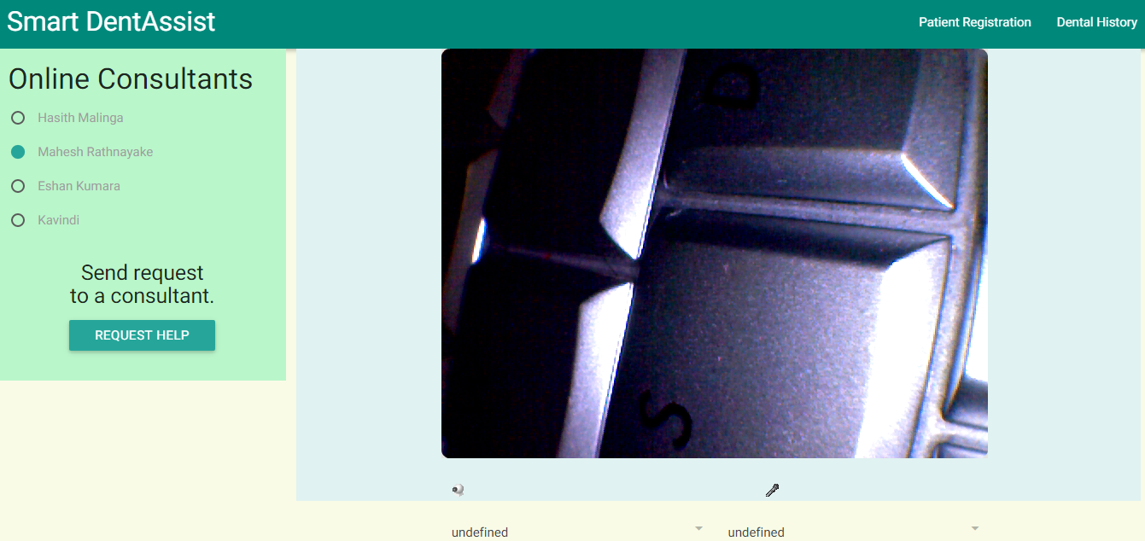

Slide 34
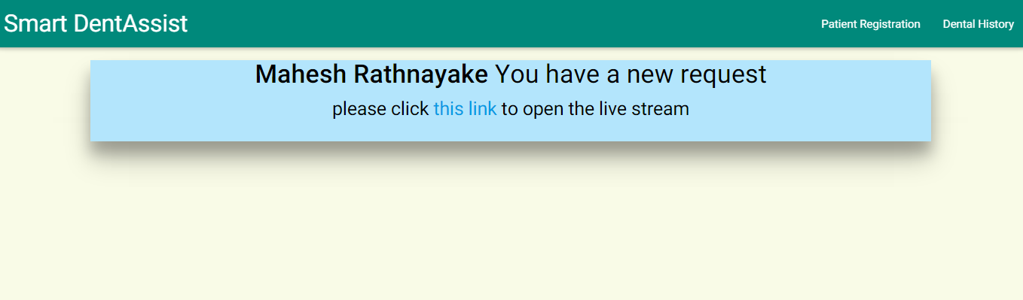

Slide 35
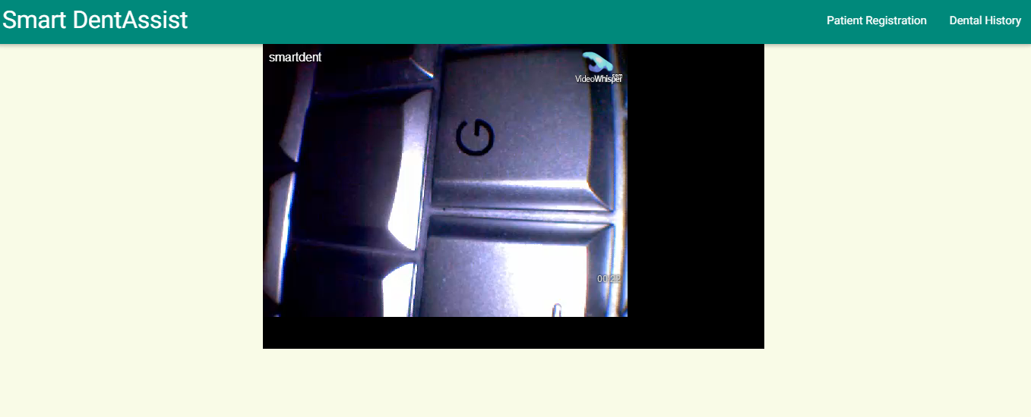

Slide 36
Teleconferencing System
The dentist can teleconference with other dentists to live stream video
The system will also transmit images or video from the intra oral camera to a tablet

Slide 37
Telconferencing System
Technologies Used
Php
JavaScript, jQuery
MySQL
RTMP Protocol

Slide 38
PATIENT MANAGEMENT SYSTEM
DENTAL INFORMATION KNOWLEDGE BASE
TELECONFERENCING SYSTEM
DIAGNOSIS, TREATMENT, SIMULATION

Slide 39
Diagnosis

Slide 40
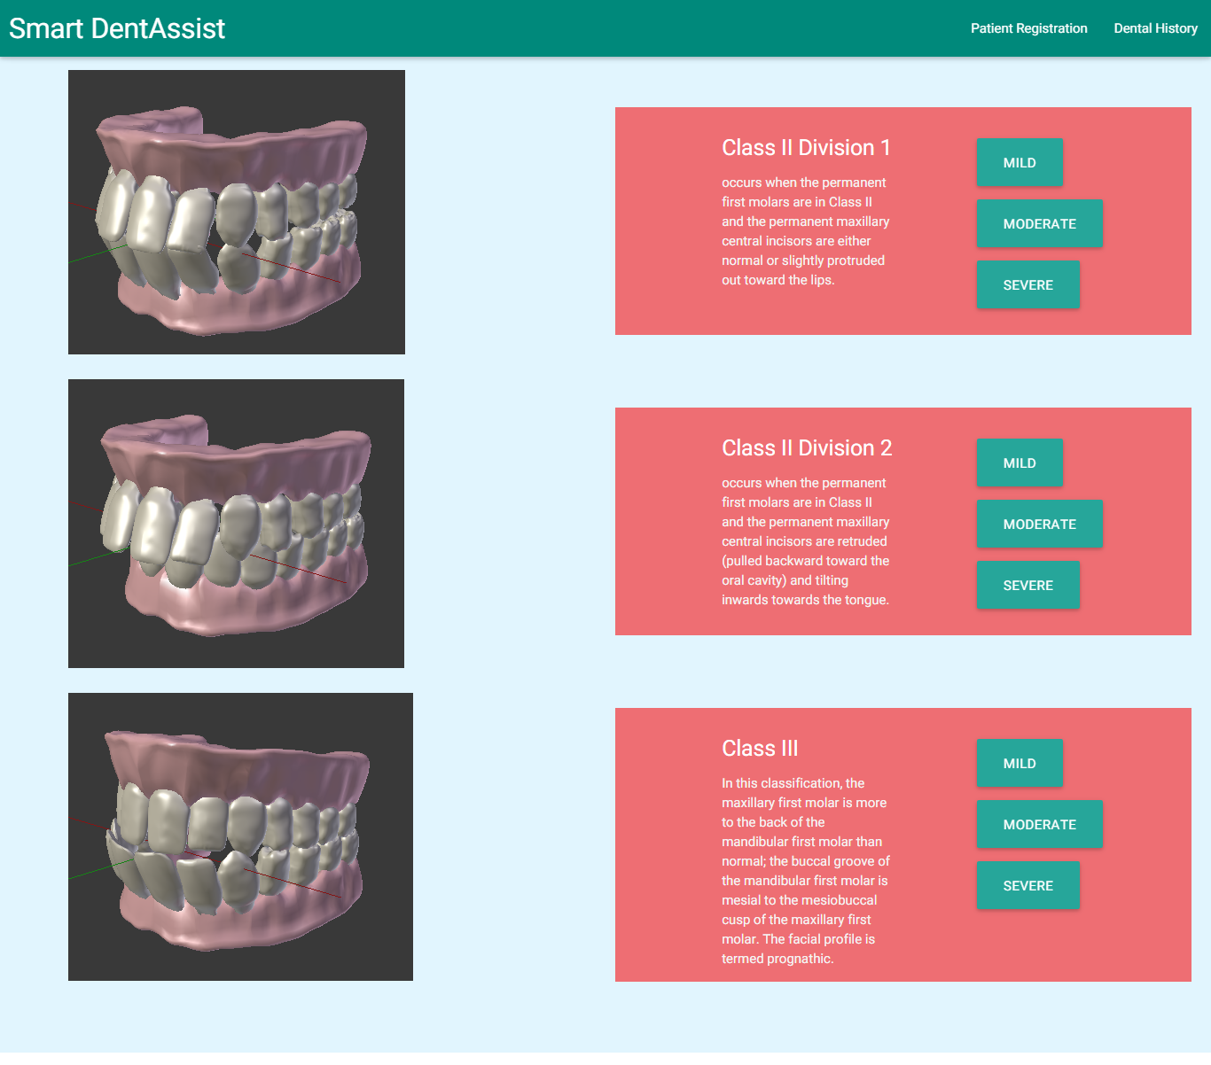

Slide 41
Simulation

Slide 42
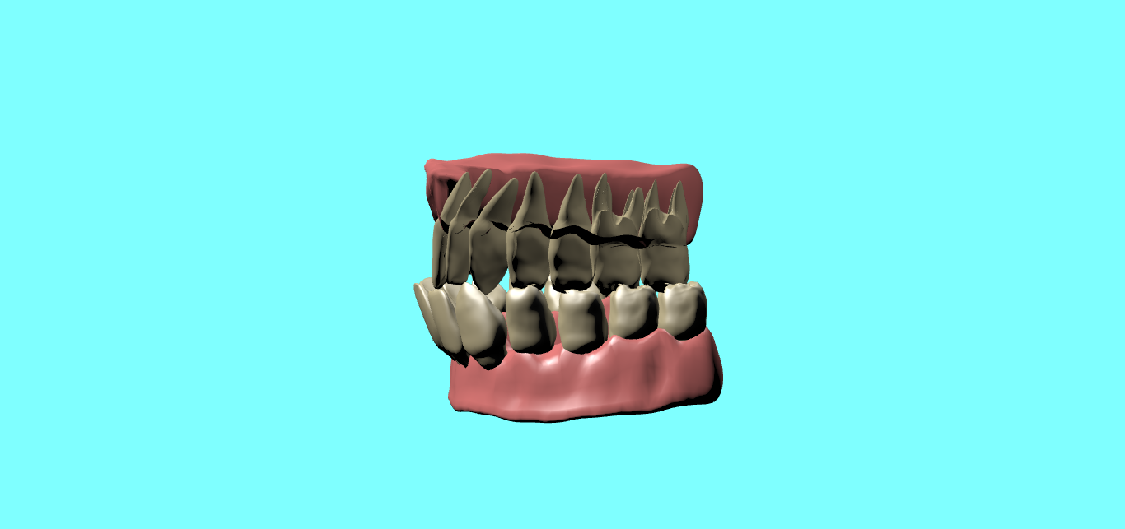
Notes:
Class D severe

Slide 43
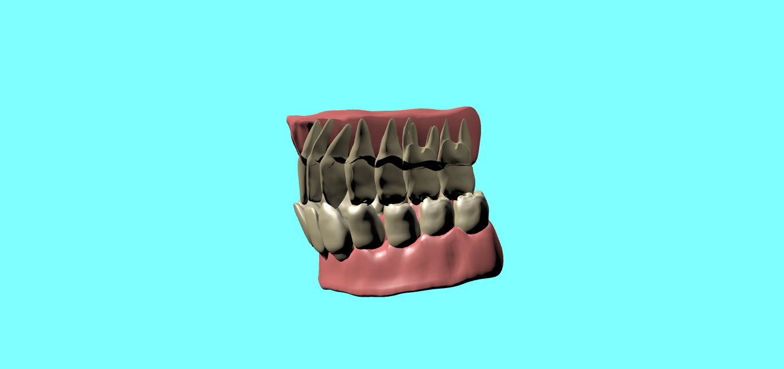
Notes:
Class D moderate

Slide 44
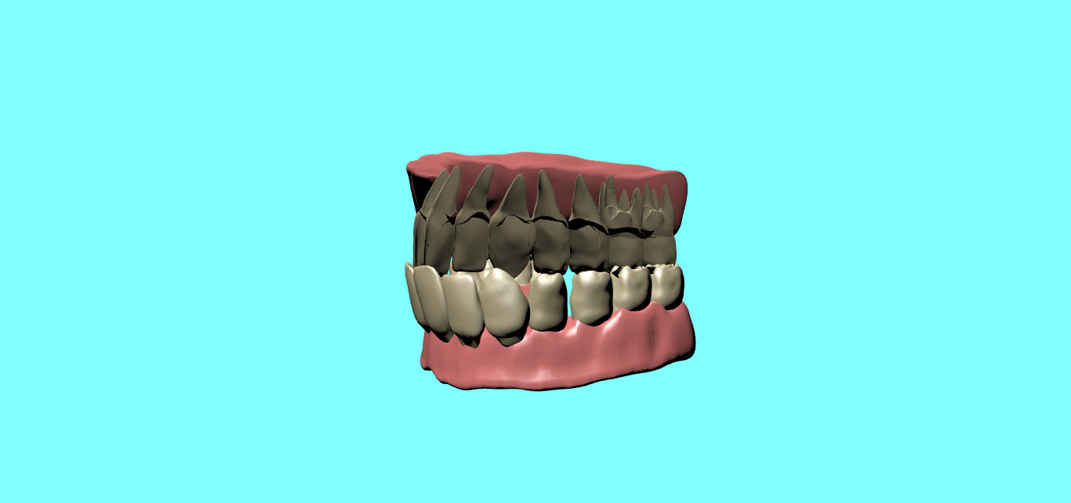
Notes:
Class D mild

Slide 45
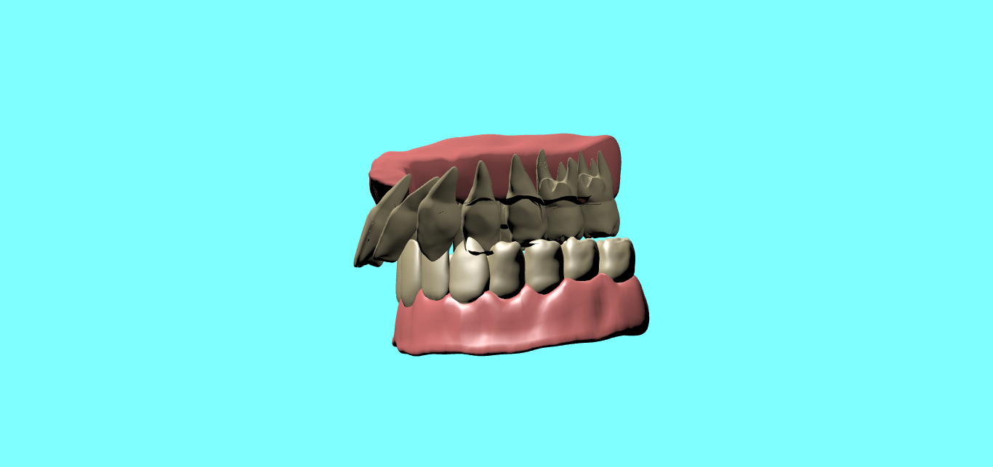
Notes:
Class C Severe

Slide 46
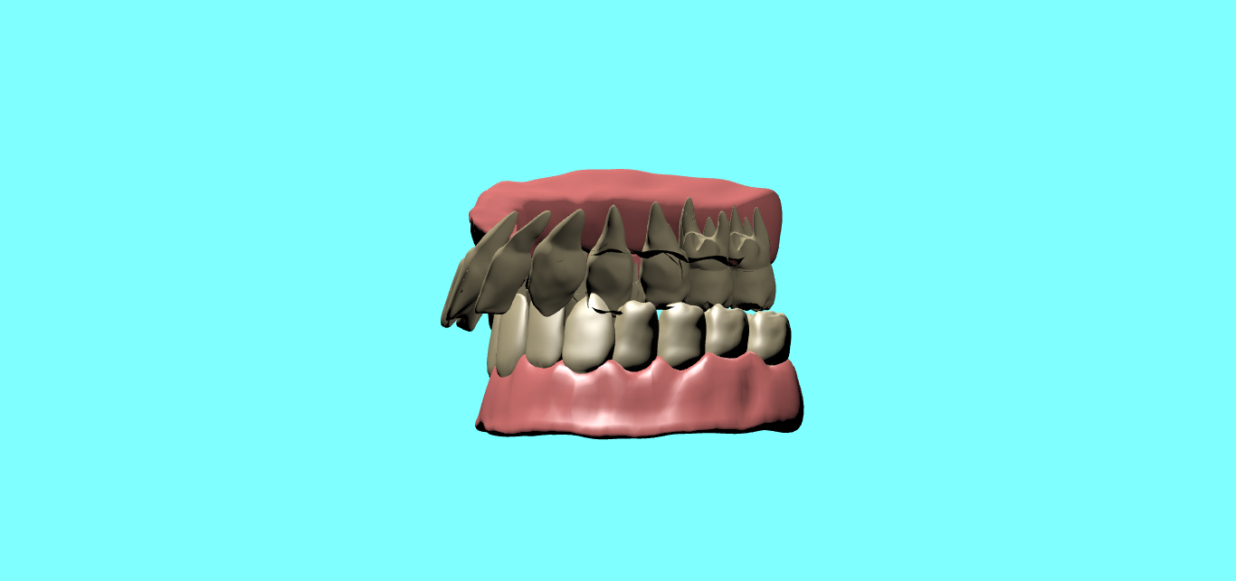
Notes:
Class C moderate

Slide 47
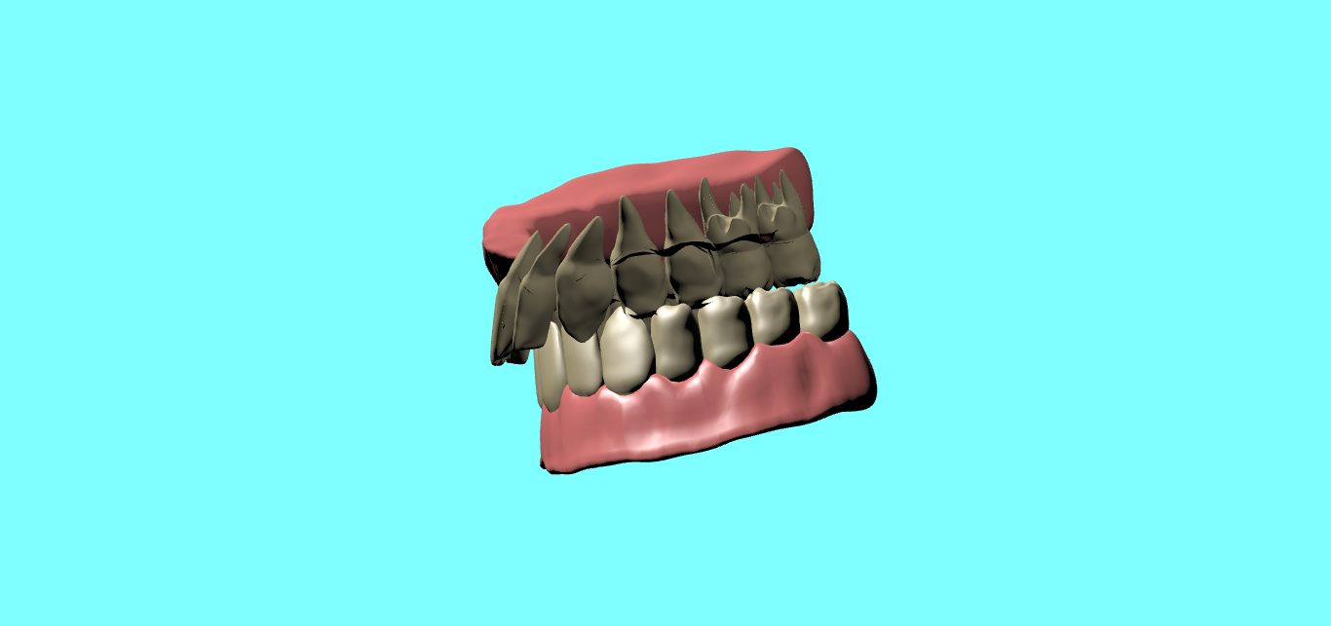
Notes:
Class C mild

Slide 48
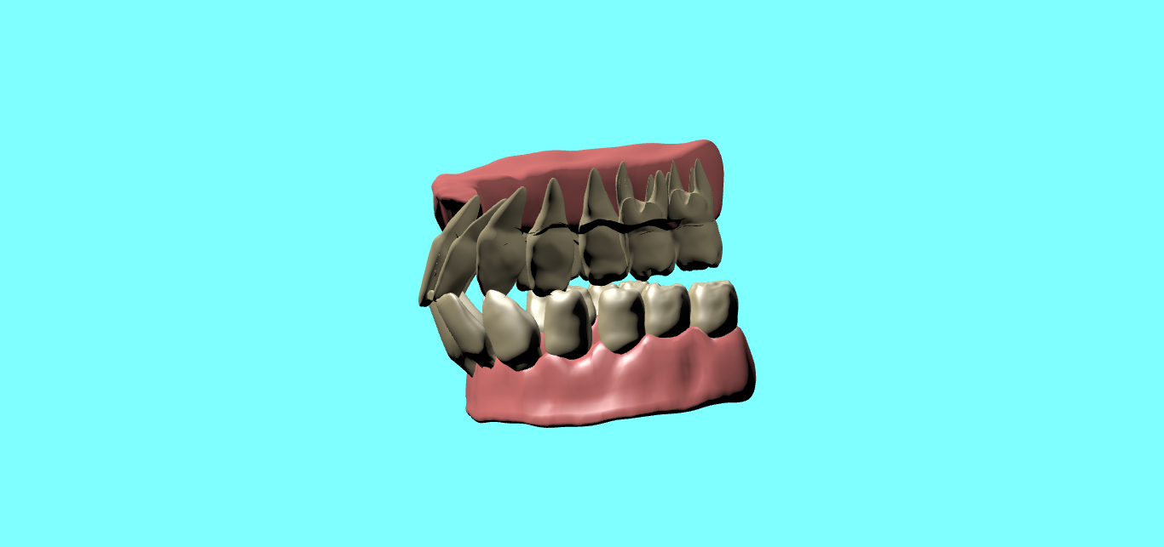
Notes:
Class B severe

Slide 49
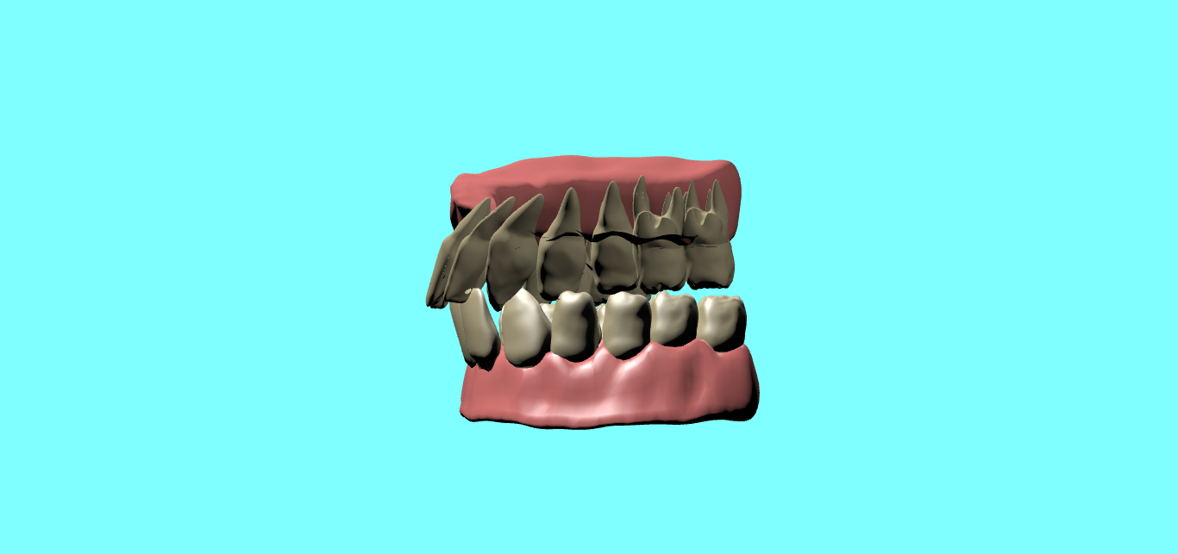
Notes:
Class B moderate

Slide 50
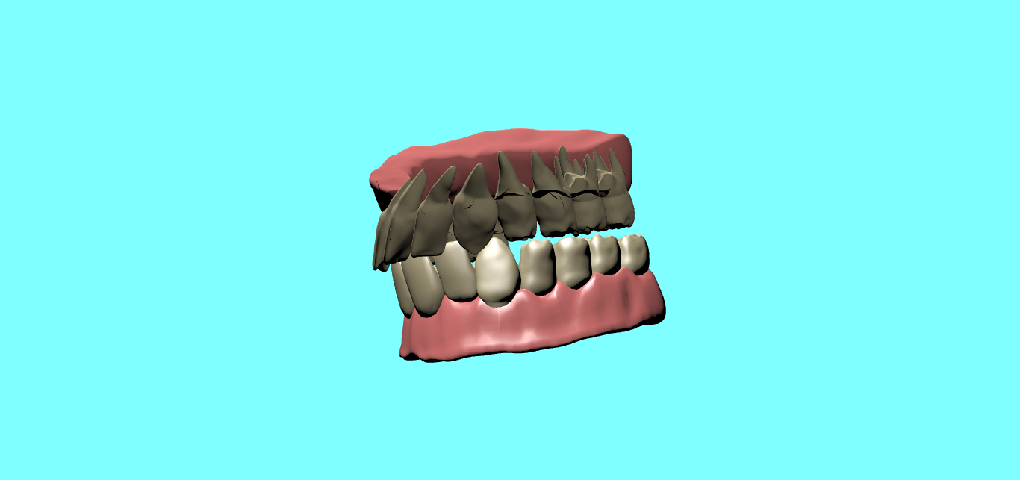
Notes:
Class B mild

Slide 51
Diagnosing, treating and simulating outcome
The system models patients’ jaw structures
The system simulates the outcome of treatments using 3D modelling
Any modification to a tooth is displayed on the 3D model
The system will convert 2D images to 3D images

Slide 52
Diagnosing, treating and simulating outcome
Technologies Used
Php
JavaScript, jQuery
Blender
X3dom
WebGL

Slide 53
Thank You!

